Slide 1
Introduction to Data Management DATA 514
Beyond Relational Data Bases:
NoSQL, JSON, Semi-structured Data

Slide 2
Announcments
HW6 (AsterixDB) is posted

Slide 3
Class Overview
Unit 1: Intro
Unit 2: Relational Data Models and Query Languages
Unit 3: RDMBS internals and query optimization
Unit 4: DBMS usability, conceptual design
Unit 5: Transactions
Unit 6: Non-relational data
NoSQL
JSON
SQL++
Unit 7: Advanced topics (time permitting)
Notes:
For each item, say why we are learning about it.

Slide 4
Historically, Two Classes of Database Applications
OLTP (Online Transaction Processing)
Queries are simple lookups: 0 or 1 join E.g., find customer by ID and their orders
Many updates. E.g., insert order, update payment
Consistency is critical: transactions
OLAP (Online Analytical Processing)
aka “Decision Support”
Queries have many joins, and group-by’s (e.g., roll-ups) E.g., sum revenues by store, product, clerk, date
No updates

Slide 5
NoSQL Motivation
Originally motivated by Web 2.0 applications
E.g. Facebook, Amazon, Instagram, etc
Web startups need to scaleup from 10 to 100,000 users or smart devices very quickly
Needed: very large scale OLTP workloads
Give up on consistency
Give up OLAP
Notes:
social networking sites, blogs, wikis, video sharing sites, hosted services, web applications, mashups and folksonomies.

Slide 6
Limitations of RDBMS?
Single server DBMSes are too small for Web data
Solution: scale out to multiple database servers
Difficult without relaxing the consistency associated with transaction processing
shared disk partitioning
distributed with 2-stage commit
shared nothing parallelism

Slide 7
Limitations of RDBMS technology
Data model
⇩
<normalization>
⇩
Relations/Tables
Pattern not ideal for many types of data sets
tree-structured XML
Objects (including JSON)

Slide 8
RDBMS Review: Serverless
Desktop
User
SQLite:
One data file
single user
One DBMS application
Consistency is easy
But only a limited number of scenarios work with such model
DBMS Application
(SQLite)
File
Data file
Disk

Slide 9
RDBMS Review: Client-Server
Client Applications
Server Machine
DB Server
File 1
Connection (JDBC, ODBC)
File 2
File 3
One server running the database
Many clients, connecting via the ODBC or JDBC (Java Database Connectivity) protocol

Slide 10
RDBMS Review: Client-Server
Many users and apps
Consistency is harder → transactions
Client Applications
Server Machine
DB Server
File 1
Connection (JDBC, ODBC)
File 2
File 3
One server running the database
Many clients, connecting via the ODBC or JDBC (Java Database Connectivity) protocol

Slide 11
Client-Server
One server that runs the DBMS (or RDBMS):
Your own desktop, or
Some beefy system, or
A cloud service (SQL Azure)

Slide 12
Client-Server
One server that runs the DBMS (or RDBMS):
Your own desktop, or
Some beefy system, or
A cloud service (SQL Azure)
Many clients run apps and connect to DBMS
Microsoft’s Management Studio (for SQL Server), or
psql (for postgres)
Some Java program or some C++ program

Slide 13
Client-Server
One server that runs the DBMS (or RDBMS):
Your own desktop, or
Some beefy system, or
A cloud service (SQL Azure)
Many clients run apps and connect to DBMS
Microsoft’s Management Studio (for SQL Server), or
psql (for postgres)
Some Java program (HW8) or some C++ program
Clients “talk” to server over secure connections using JDBC/ODBC protocol

Slide 14
Web Apps: 3 Tier
Browser
DB Server
File 1
File 2
File 3
Notes:
Mention scalability by adding servers.

Slide 15
Web Apps: 3 Tier
Browser
DB Server
App+Web Server
File 1
Connection
(e.g., JDBC)
File 2
HTTP/SSL
File 3
Notes:
Mention scalability by adding servers.
Example is using browser to talk to SQL Azure database.

Slide 16
Web Apps: 3 Tier
Web-based applications
Browser
DB Server
App+Web Server
File 1
Connection
(e.g., JDBC)
File 2
HTTP/SSL
File 3
Notes:
Mention scalability by adding servers.

Slide 17
Web Apps: 3 Tier
Web-based applications
App+Web Server
DB Server
File 1
Connection
(e.g., JDBC)
App+Web Server
File 2
HTTP/SSL
File 3
App+Web Server
Notes:
Mention scalability by adding servers.

Slide 18
Web Apps: 3 Tier
Replicate App server for scaleup
Web-based applications
App+Web Server
DB Server
File 1
Connection
(e.g., JDBC)
App+Web Server
File 2
HTTP/SSL
File 3
App+Web Server
Why not also replicate DB server?
Notes:
Mention scalability by adding servers.

Slide 19
Web Apps: 3 Tier
Replicate App server for scaleup
Web-based applications
App+Web Server
DB Server
File 1
Connection
(e.g., JDBC)
App+Web Server
File 2
HTTP/SSL
File 3
App+Web Server
Why not replicate DB server?
Consistency!
Notes:
Mention scalability by adding servers.

Slide 20
Replicating the Database
Two basic approaches:
Scale up through partitioning
Scale up through replication
Consistency is much harder to guarantee
When is a committed Write complete?
Without consistency, data integrity problems arise in VLDBs that are very difficult to resolve

Slide 21
Scale Through Disk Partitioning
Database runs on a single server that is a shared memory multiprocessor
Partition the database across multiple (shared) disks
Any thread can write to any disk
Queries spread across these machines
Designed to increase throughput
Disks
Server

Slide 22
RDBMS Architecture
Read
Requests
OS
DBMS Process
Write
Requests
Buffer Manager
Worker
Thread Pool
Occupied
Free
Dirty
bottleneck?
Reads
Write
Write
Log

Slide 23
Scale Through Partitioning
Partition the database across multiple machines in a cluster
Queries spread across these machines
Can increase throughput
Easy for writes, but reads become more expensive!
Application updates here
May also update here
Multiple partitions
Shared Disk

Slide 24
Scale Through Replication
Create multiple copies of each database partition
High Availability & Failover
Spread queries across these replicas
Can increase throughput and lower network latency
Can also improve fault-tolerance
Easy for reads but writes become expensive!
App 1 updates here only
App 2 updates here only
Multiple replicas
Shared Nothing

Slide 25
Concurrency
Parallel Computation
Huge topic in CS, encompassing Hardware, Software, compilers, algorithms, etc.
How can parallelism be applied to different workloads?
inherent parallelism (e.g., transaction processing)
parallel algorithms (e.g., “Divide & Conquer”, SIMD)
Built into the SQL Query Optimizer
serial algorithms that (so far) resist parallelism
What are some of the key performance limitations parallel computing encounters?

Slide 26

SIMD : Single Instruction/Multiple Data
Explicit parallelism
Fork : Join
“Divide and Conquer” pattern
e.g., parallel Search
Danny Hillis’s Connection Machine demonstration
Massively Parallel Processors (MPPs)
MapReduce (see Hadoop, Spark)

Slide 27
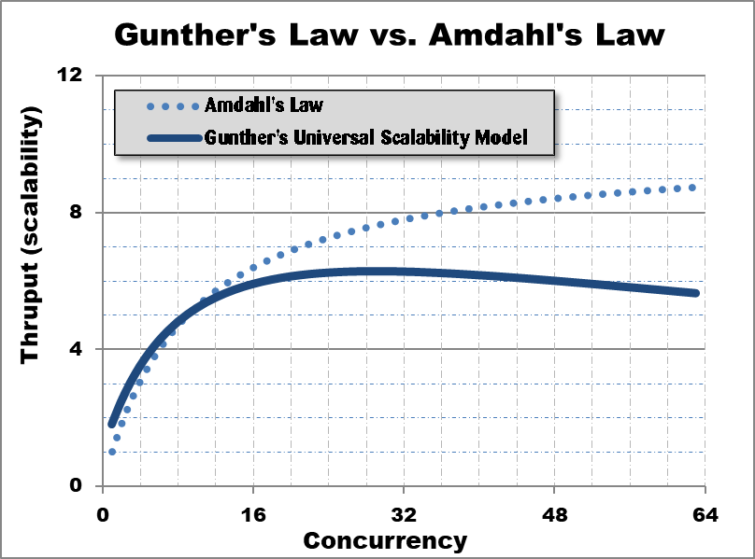
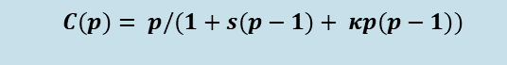
Gunther’s Law
The Limits of Parallel Programming
Model Parameters:
serial portion = 10%
K = 0.001
$$C(p)= p/(1+s(p−1)+ κp(p−1))$$

Slide 28
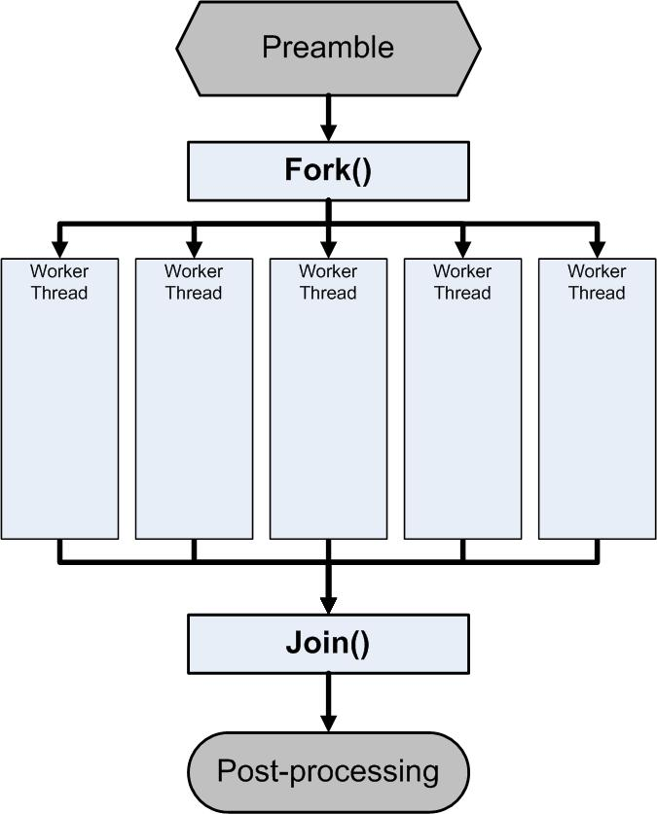
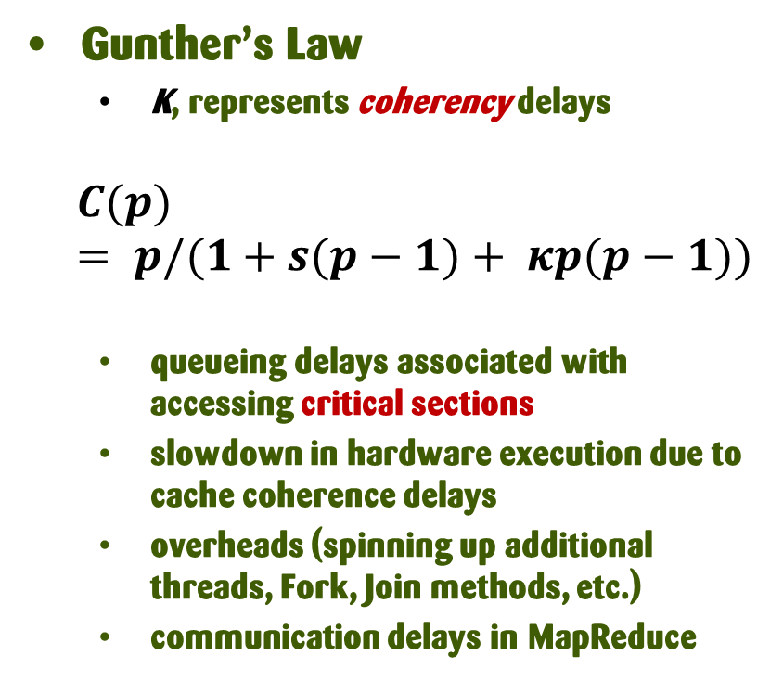
The Limits of Parallel Programming
Gunther’s Law
K, represents coherency delays
$$C(p)= p/(1+s(p−1)+ κp(p−1))$$
queueing delays associated with accessing critical sections
slowdown in hardware execution due to cache coherence delays
overheads (spinning up additional threads, Fork, Join methods, etc.)
communication delays in MapReduce
1-p
p
1-p

Slide 29
Relational Model → NoSQL
Relational DB: difficult to replicate/partition
Given Supplier(sno,…),Part(pno,…),Supply(sno,pno)
Partition: we may be forced to join across servers
Replication: local copy has inconsistent versions
Consistency is hard in both cases (why?)
Strict consistency uses Two-phase commit

Slide 30
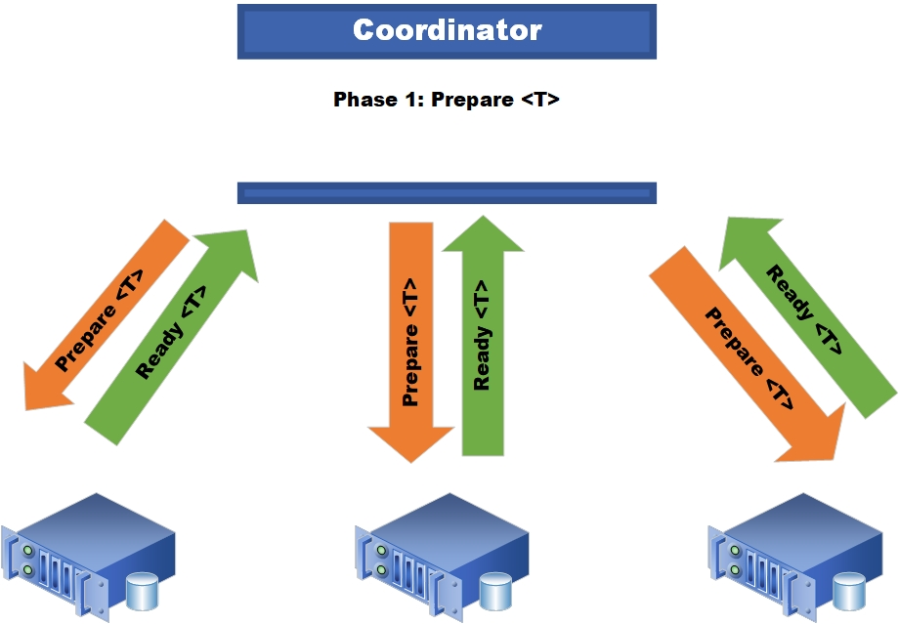
Two-phase commit
Phase 1

Slide 31
Two-phase commit: Phase 1
Distributed Transaction Coordinator
usually associated with a Master node
send Prepare<T> requests to all participating nodes
Await Ready<T> replies
Hold EXCLUSIVE locks at each node

Slide 32
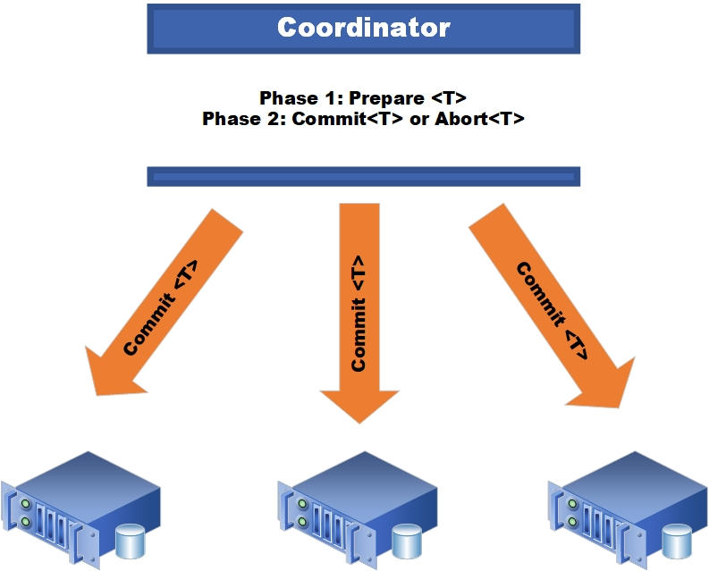
Two-phase commit: Phase 2

Slide 33
Relational Model → NoSQL
Relational DB: difficult to replicate/partition
Given Supplier(sno,…),Part(pno,…),Supply(sno,pno)
Partition: we may be forced to join across servers
Replication: local copy has inconsistent versions
Consistency is hard in both cases (why?)
Two-stage Commit
NoSQL: simplified data model
Gives up some functionality
e.g., force application to handle JOINs and transaction-based consistency

Slide 34

CAP
Partitioning
Latency between nodes
function of distance,
geographical distribution of nodes
Trade-offs among
Consistency
Strong ⇨ Eventual consistency
Availability
failover to a replica
synchronous or asynchronous replication

Slide 35
CAP
e.g., Consistency models in Azure CosmoDB
a range of options:
Read throughput varies with the consistency level
Availability and failover based on:
recovery time objective (RTO)
recovery point objective (RPO)
where CAP theorems “prove” RTO and RPO cannot both be instantaneous
e.g., Master/Slave: Eventual RTO, RPO < 15 minutes
Strong
Bounded
staleness
Session
Consistent
Prefix
Eventual

Slide 36
noSQL Data Models
Taxonomy based on data models:
Key-value stores
e.g., Project Voldemort, memcached
Document stores
e.g., SimpleDB, CouchDB, MongoDB
Extensible Record Stores
e.g., HBase, Cassandra, PNUTS
Notes:
Voldemort is supported by linkedin
A “document” allows values to be nested documents or lists as well as scalar values, and the attribute names are dynamically defined for each document at runtime. A document differs from a tuple in that the attributes are not defined in a global schema, and this wider range of values are permitted.
An “extensible record” is a hybrid between a tuple and a document, where families of attributes are defined in a schema, but new attributes can be added (within an attribute family) on a per-record
basis. Attributes may be list-valued.

Slide 37
Key-Value Stores Features
Data model: (key,value) pairs
Key = string/integer, unique for the entire data
Value = can be anything (very complex object)
Consistent with parallel processing frameworks based on Map/Reduce ⇨ Hadoop, Spark, etc.

Slide 38
Key-Value Stores Features
Data model: <key, value> pairs
Key = string/integer, unique for the entire data
Value = can be anything (very complex object)
Operations
get(key), put(key,value)
Operations on value not supported

Slide 39
Key-Value Stores Features
Data model: (key,value) pairs
Key = string/integer, unique for the entire data
Value = can be anything (very complex object)
Operations
get(key), put(key,value)
Operations on value not supported
Distribution / Partitioning – w/ hash function
No replication: key k is stored at server h(k)
3-way replication: key k stored at h1(k),h2(k),h3(k)

Slide 40
Key-Value Stores Features
Data model: (key,value) pairs
Key = string/integer, unique for the entire data
Value = can be anything (very complex object)
Operations
get(key), put(key,value)
Operations on value not supported
Distribution / Partitioning – w/ hash function
No replication: key k is stored at server h(k)
3-way replication: key k stored at h1(k),h2(k),h3(k)
How does get(k) work? How does put(k,v) work?

Slide 41
Example
Flights(fid, date, carrier, flight_num, origin, dest, ...)
Carriers(cid, name)
How would you represent the Flights data as key, value pairs?
How does query processing work?

Slide 42
Example
Flights(fid, date, carrier, flight_num, origin, dest, ...)
Carriers(cid, name)
How would you represent the Flights data as key, value pairs?
Option 1: key=fid, value=entire flight record
How does query processing work?

Slide 43
Example
Flights(fid, date, carrier, flight_num, origin, dest, ...)
Carriers(cid, name)
How would you represent the Flights data as key, value pairs?
Option 1: key=fid, value=entire flight record
Option 2: key=date, value=all flights that day
How does query processing work?

Slide 44
Example
Flights(fid, date, carrier, flight_num, origin, dest, ...)
Carriers(cid, name)
How would you represent the Flights data as key, value pairs?
Option 1: key=fid, value=entire flight record
Option 2: key=date, value=all flights that day
Option 3: key=(origin,dest), value=all flights between
How does query processing work?

Slide 45
Key-Value Stores Internals
Partitioning:
Use a hash function h, and store every (key,value) pair on server h(key)
In class: discuss get(key), and put(key,value)
Replication:
Store each key on (say) three servers
On update, propagate change to the other servers; eventual consistency
Issue: when an app reads one replica, it may be stale
Usually: combine partitioning + replication
Notes:
No other secondary indices

Slide 46
Data Models
Taxonomy based on data models:
Key-value stores
e.g., Project Voldemort, Memcached
Document stores
e.g., SimpleDB, CouchDB, MongoDB
Extensible Record Stores
e.g., HBase, Cassandra, PNUTS
☞
Notes:
Voldemort is supported by linkedin
A “document” allows values to be nested documents or lists as well as scalar values, and the attribute names are dynamically defined for each document at runtime. A document differs from a tuple in that the attributes are not defined in a global schema, and this wider range of values are permitted.
An “extensible record” is a hybrid between a tuple and a document, where families of attributes are defined in a schema, but new attributes can be added (within an attribute family) on a per-record
basis. Attributes may be list-valued.

Slide 47
Motivation
In Key, Value stores, the Value is often a very complex object
Key = ‘2010/7/1’, Value = [all flights that date]
Better: allow DBMS to understand the value
Represent value as a JSON (or XML...) document
[all flights on that date] = a JSON file
May search for all flights on a given date

Slide 48
Document Stores Features
Data model: <key, document> pairs
Key = string/integer, unique for the entire dataset
Document = JSON or XML (older)
tree-structured
Operations
Get/Put document by key
Query language over JSON
Distribution / Partitioning
Entire documents, as for key/value pairs
We will discuss JSON
Notes:
----- Meeting Notes (2/10/16 15:22) -----

Slide 49
Data Models
Taxonomy based on data models:
Key-value stores
e.g., Project Voldemort, Memcached
Document stores
e.g., SimpleDB, CouchDB, MongoDB
Extensible Record Stores
e.g., HBase, Cassandra, PNUTS
☞
Notes:
Voldemort is supported by linkedin
A “document” allows values to be nested documents or lists as well as scalar values, and the attribute names are dynamically defined for each document at runtime. A document differs from a tuple in that the attributes are not defined in a global schema, and this wider range of values are permitted.
An “extensible record” is a hybrid between a tuple and a document, where families of attributes are defined in a schema, but new attributes can be added (within an attribute family) on a per-record
basis. Attributes may be list-valued.

Slide 50
Extensible Record Stores
Based on Google’s BigTable
Data model is rows and columns
Scalability by splitting rows and columns over nodes
Rows partitioned through sharding on primary key
Columns of a table are distributed over multiple nodes by using “column groups”
HBase is an open source implementation of BigTable
Notes:
The column groups must be pre-defined with the
extensible record stores. However, that is not a big
constraint, as new attributes can be defined at any time

Slide 51
Introduction to Data Management DATA 514
JSON, Semistructured Data, SQL++

Slide 52
Where We Are
So far we have studied the relational data model
Data is stored in tables(=relations)
Queries are expressions in SQL, relational algebra, or Datalog
Today: Semi-structured data model
Popular formats today: XML, JSON, protobuf

Slide 53
JSON - Overview
JavaScript Object Notation: a lightweight, text-based, Open standard designed for data interchange.
JavaScript runs in the web browser
Interfaces available in most languages, including C++, C#, Java, Python, Perl, etc.
Clear text: human-readable
The filename extension is .json.
We will refer to JSON as semi-structured data

Slide 54
JSON Syntax
{ "book": [
{"id":"01",
"language": "Java",
"author": "H. Javeson",
"year": 2015
},
{"id":"07",
"language": "C++",
"edition": "second"
"author": "E. Sepp",
"price": 22.25
}
]
}
Notes:
http://www.tutorialspoint.com/json/json_quick_guide.htm

Slide 55
JSON vs. Relational
Relational data model
Rigid flat structure (tables)
Schema must be fixed in advanced
Binary representation: good for performance, bad for exchange
Query language based on Relational Calculus
Semi-structured data model / JSON
Flexible, nested structure (trees)
Does not require predefined schema ("self describing”)
Text representation: good for exchange, bad for performance
Most common use: Language API; query languages emerging

Slide 56
JSON Terminology
Data is represented in name/value pairs.
Curly braces hold objects
Each object is a list of name/value pairs separated by , (comma)
Each pair is a name is followed by :(colon) followed by the value
Square brackets hold ordered arrays and values are separated by ,(comma).
Notes:
http://www.tutorialspoint.com/json/json_quick_guide.htm

Slide 57
JSON Data Structures
Objects, i.e., collections of name-value pairs:
{“name1”: value1, “name2”: value2, …}
“name” is also called a “key”
Ordered lists of values:
[obj1, obj2, obj3, ...]
Notes:
http://www.tutorialspoint.com/json/json_quick_guide.htm

Slide 58
Avoid Using Duplicate Keys
The standard allows them, but many implementations don’t
Use an ordered list instead
{"id":"07",
"title": "Databases",
"author": "Garcia-Molina",
"author": "Ullman",
"author": "Widom"
}
{"id":"07",
"title": "Databases",
"author": ["Garcia-Molina",
"Ullman",
"Widom"]
}

Slide 59
JSON Primitive Datatypes
Number
String
Denoted by double quotes
Boolean
Either true or false
null empty
Notes:
http://www.tutorialspoint.com/json/json_quick_guide.htm

Slide 60
JSON vs. XML
{“person”:
[ {“name”: “Mary”,
“address”: {“street”:“Maple”, “no”:345, “city”: “Seattle”}}, {“name”: “John”, “address”: “Thailand”, “phone”:2345678}} ]
}
<person>
<name> Mary </name>
<address>
<street> Maple </street>
<no>345 </no>
<city> Seattle </city>
</address>
</person>
<person>
<name> John</name>
<address> Thailand </address>
<phone> 2345678 </phone>
</person>

Slide 61
JSON Semantics: a Tree !
person
{“person”:
[ {“name”: “Mary”,
“address”: {“street”:“Maple”, “no”:345, “city”: “Seattle”}}, {“name”: “John”, “address”: “Thailand”, “phone”:2345678}} ]
}
[0]
[1]
name
address
name
address
phone
Mary
street
no
city
Thai
John
23456
Maple
345
Seattle

Slide 62
JSON Semantics: a Tree !
person
{“person”:
[ {“name”: “Mary”,
“address”: {“street”:“Maple”, “no”:345, “city”: “Seattle”}}, {“name”: “John”, “address”: “Thailand”, “phone”:2345678}} ]
}
Object[0]
Object[1]
name
address
name
address
phone
Mary
street
no
city
Thai
John
23456
Maple
345
Seattle
Note: arrays are ordered in JSON!

Slide 63
JSON Data
JSON is self-describing
similar to XML, but even more verbose
Schema elements are included with the data
Relational schema: person(name,phone)
In Json “person”, “name”, “phone” are part of the data, and are repeated many times
Consequence: JSON is more flexible
JSON = semi-structured data
Notes:
Semistructured data: schema is implied by the data rather than being declared separately from the data. Schema can vary arbitrarily both over time and within a single database.

Slide 64
Mapping Relational Data to JSON
person
Person
name
phone
name
phone
name
phone
“John”
3634
“Sue”
6343
“Dirk”
6363
name | phone
John | 3634
Sue | 6343
Dirk | 6363
{“person”: [ {“name”: “John”, “phone”:3634}, {“name”: “Sue”, “phone”:6343},
{“name”: “Dirk”, “phone”:6383} ]
}

Slide 65
Mapping Relational Data to JSON
“inline” multiple relations JOINed using foreign key references
Person
{“Person”:
[{"name": "John",
"phone":3646, "Orders":[ {"date":2002,"product":"Gizmo"}, {“date”:2004,"product":"Gadget"} ]
},
{"name": "Sue", "phone":6343, "Orders":[
{"date":2002,"product":"Gadget"} ]
}
]
}
name | phone
John | 3634
Sue | 6343
Orders
personName | date | product
John | 2002 | Gizmo
John | 2004 | Gadget
Sue | 2002 | Gadget

Slide 66
JSON is Semi-Structured Data
Missing attributes:
Could represent in a DB table using nulls
{“person”: [{“name”:“John”, “phone”:1234}, {“name”:“Joe”}] }
no phone;
no foul !
name | phone
John | 1234
Joe | NULL

Slide 67
JSON is Semi-Structured Data
Repeating attributes (arrays)
{“person”: [{“name”:”John”, “phone”:1234}, {“name”:”Mary”, “phone”:[1234,5678]}] }
Two phones !
name | phone
Mary | 2345 | 3456
Dynamic schemas?
???

Slide 68
JSON is Semi-Structured Data
Attributes with different types in different objects
Nested collections
Heterogeneous collections
which are difficult to represent in the relational model
{“person”: [{“name”:“Sue”, “phone”:3456}, {“name”:{“first”:“John”, “last”:“Smith”},“phone”:2345} ] }
Structured name !

Slide 69
Discussion: Why Semi-Structured Data?
Sellf-describing semi-structured data is used in data exchange
i.e., exchanging data between different apps
Examples: XML, JSON, Protobuf (protocol buffers)
Increasingly used as the data model for scalable, distributed databases:
SQL Server supports for XML-valued relations
MongoDB, CosmoDB: JSON as data model
Dremel (BigQuery): Protobuf as data model

Slide 70
Query Languages for Semi-Structured Data
XML: XPath, XQuery (see textbook)
Supported inside many RDBMS (SQL Server, DB2, Oracle)
Several standalone XPath/XQuery engines
Protobuf: SQL-ish language (Dremel) used internally by Google, and externally in BigQuery
JSON:
CouchBase: N1QL
Asterix: SQL++ (based on SQL)
MongoDB: has a pattern-based language
JSONiq http://www.jsoniq.org/

Slide 71
AsterixDB
No-SQL database system
Developed at UC Irvine
Now an Apache project, being incorporated into CouchDB (another No-SQL DB)
Uses JSON as data model
Query language: SQL++
SQL-like syntax for JSON data

Slide 72
Asterix Data Model (ADM)
Based on the JSON standard
Objects:
{“Name”: “Alice”, “age”: 40}
Fields must be distinct: {“Name”: “Alice”, “age”: 40, “age”:50}
Ordered arrays:
[1, 3, “Fred”, 2, 9]
Can contain values of different types
Multisets (aka bags):
{{1, 3, “Fred”, 2, 9}}
Mostly internal use only but can be used as inputs
All multisets are converted into ordered arrays (in arbitrary order) when returned at the end
No repeated fields

Slide 73
Examples
What do these queries return?
SELECT x.phone FROM [{"name": "Alice", "phone": [300, 150]}] AS x;
SELECT x.phone FROM {{ {"name": "Alice", "phone": [300, 150]} }} AS x;
Can only query from multi-set or array (not object)
-- error
SELECT x.phone FROM {"name": "Alice", "phone": [300, 150]} AS x;

Slide 74
Primitive Datatypes
Boolean, integer, float (various precisions), special geometry (point, line, …), date, time, etc
UUID = universally unique identifier Use it as a system-generated unique key

Slide 75
Both null & missing are valid
{"age": null} = the value NULL (like in SQL)
{"age": missing} = { } = really missing
SELECT x.b FROM [{"a":1, "b":2}, {"a":3}] AS x;
{"b": 2} { }
Answer
SELECT x.b FROM [{"a":1, "b":2}, {"a":3, "b":null }] AS x;
{"b": 2} {"b": null }
Answer
SELECT x.b FROM [{"a":1, "b":2}, {"a":3, "b":missing }] AS x;
{"b": 2} { }
Answer

Slide 76
SQL++ ≅ SQL
SELECT x.age FROM Person AS x
WHERE x.age > 21 GROUP BY x.gender
HAVING x.salary > 10000
ORDER BY x.name;
is exactly the same as
FROM Person AS x
WHERE x.age > 21
GROUP BY x.gender
HAVING x.salary > 10000
SELECT x.age
ORDER BY x.name;
FWGHOS
lives!!
Notes:
They got the ordering of clauses right!!

Slide 77
SQL++ Overview
Data Definition Language: create a
Type
Dataset (like a relation)
Dataverse (a collection of datasets)
Index
For speeding up query execution
Data Manipulation Language:
SELECT-FROM-WHERE

Slide 78
SQL++ Overview
SQL++ ≠ SQL-92
SQL++ does not support:
CROSS JOIN, NATURAL JOIN, UNION JOIN
RIGHT and FULL OUTER JOIN
INTERSECT, EXCEPT, UNION with set semantics
CAST expression
COALESCE expression
ALL and SOME predicates for linking to subqueries
UNIQUE predicate (tests a collection for duplicates)
MATCH predicate (tests for referential integrity)
UPSERT, not UPDATE
no multi-statement transactions

Slide 79
Dataverse
A Dataverse ≅ Database
a collection of datasets (i.e., tables)
CREATE DATAVERSE myDB
CREATE DATAVERSE myDB IF NOT EXISTS
DROP DATAVERSE myDB
DROP DATAVERSE myDB IF EXISTS
USE myDB

Slide 80
Type
JSON objects + data-oriented extensions
Defines the schema of a collection
lists all the required fields of a valid object instance
primitive types:
int, string, point, line, rectangle, datetime, duration, etc.
derived types:
nested Objects
Arrays [a, b, c, d]
Multisets (aka, bags) {{“a”, “b”, 1, “c”, “d”, “e”}}
Fields followed by ? are optional (i.e., nullable)

Slide 81
Type
CLOSED type :
no other fields allowed
compact: one copy of the metadata is stored
OPEN type :
additional fields not in the Type definition are allowed,
but metadata for additional fields is stored in each instance of the Type (i.e., added to the tree)
instances of Types are stored as trees

Slide 82
Closed Types
USE myDB;
DROP TYPE PersonType IF EXISTS;
CREATE TYPE PersonType AS CLOSED {
name: string,
age: int,
email: string?
}
{"name": "Alice", "age": 30, "email": "a@alice.com"}
{"name": "Bob", "age": 40}
-- not OK:
{"name": "Carol", "phone": "123456789"}

Slide 83
Open Types
USE myDB;
DROP TYPE PersonType IF EXISTS;
CREATE TYPE PersonType AS OPEN {
name: string,
age: int,
email: string?
}
{"name": "Alice", "age": 30, "email": "a@alice.com"}
{"name": "Bob", "age": 40}
-- now it’s OK:
{"name": "Carol","age":20, "phone": "123456789"}

Slide 84
Types with Nested Collections
USE myDB;
DROP TYPE PersonType IF EXISTS;
CREATE TYPE PersonType AS CLOSED {
Name : string,
phone: [string]
}
{"Name": "Carol", "phone": ["1234”]}
{"Name": "David", "phone": [“2345”, “6789”]} {"Name": "Evan", "phone": []}

Slide 85
Datasets
Dataset = relation
Must have a type
Can be a trivial OPEN type
Must have a key
Can also be a trivial one

Slide 86
Dataset with Existing Key
USE myDB;
DROP TYPE PersonType IF EXISTS;
CREATE TYPE PersonType AS CLOSED {
name: string,
email: string?
}
{“name”: “Alice”}
{“name”: “Bob”}
…
USE myDB;
DROP DATASET Person IF EXISTS;
CREATE DATASET Person(PersonType) PRIMARY KEY Name;

Slide 87
Dataset with Auto-Generated Key
Note: no myKey field since it is autogenerated
USE myDB;
DROP TYPE PersonType IF EXISTS;
CREATE TYPE PersonType AS CLOSED {
myKey: uuid,
Name : string,
email: string?
}
{“name”: “Alice”}
{“name”: “Bob”}
…
USE myDB;
DROP DATASET Person IF EXISTS;
CREATE DATASET Person(PersonType)
PRIMARY KEY myKey AUTOGENERATED;

Slide 88
NFNF
Non-First Normal Form
One or more attributes that form a collection
One extreme: a single row with a huge, nested collection
Better: multiple rows, reduced number of nested collections

Slide 89
Example from HW6
mondial.adm is semi-structured:
{“mondial”: {“country”: [...], “continent”:[...], ..., “desert”:[...]}}
country | continent | organization | sea | ... | mountain | desert
[{“name”:”Albania”,...}, {“name”:”Greece”,...}, ...] | ... | ... | ... |  | ... | ...
Nested objects!
country.adm, sea.adm, mountain.adm are more structured
Country:
-car_code | name | ... | ethnicgroups | religions | ... | city
AL | Albania | ... | [ ... ] | [ ... ] | ... | [ ... ]
GR | Greece | ... | [ ... ] | [ ... ] | ... | [ ... ]
... | ... | ... | ...

Slide 90
Indexes
Can declare an index on an attribute of a top-most collection
Types of Indexes supported:
BTREE: good for equality and range queries E.g., name=“Greece”; 20 < age and age < 40
RTREE: good for 2-dimensional range queries E.g., 20 < x and x < 40 and 10 < y and y < 50
KEYWORD: good for substring search if your dataset contains text strings
Notes:
Note: we haven’t covered indexes yet at this point

Slide 91
Indexes
Cannot index inside a nested collection
USE myDB;
CREATE INDEX countryID ON country(`-car_code`) TYPE BTREE;
USE myDB;
CREATE INDEX cityname ON country(city.name) TYPE BTREE;
AL BG GR... NZ
Country:
-car_code | name | ... | ethnicgroups | religions | ... | city
AL | Albania | ... | [ ... ] | [ ... ] | ... | [ ... ]
GR | Greece | ... | [ ... ] | [ ... ] | ... | [ ... ]
... | ... | ... | ...
BG | Belgium | ...
...
Notes:
Note: we haven’t covered indexes yet at this point

Slide 92
Introduction to Data Management DATA 514
SQL++

Slide 93
SQL++ Overview
Familiar pattern, but with important differences
not standardized!
SQL ++
tree-structured data
types can be nested
(not normalized) multi-valued arrays (bags)
SELECT …
FROM …
WHERE …
GROUP BY …
ORDER BY …
HAVING …

Slide 94
Retrieve Everything
world
{{ {“mondial”:
{“country”: [{Albania}, {Greece}, …],
“continent”: […],
“organization”: […], ... ... }
}
}}
A collection of objects
SELECT x.mondial FROM world AS x;
2. Return mondial for each x
1. Bind each object in world to x
{“mondial”:
{“country”: [ Albania, Greece, …],
“continent”: […],
“organization”: […], ... ...
}
}
Result:
Notes:
This is just like SQL. We go through every element in the collection world and bind each element as x, and return x.mondial

Slide 95
Retrieve Everything
world
{{ {“mondial”:
{“country”: [{Albania}, {Greece}, …],
“continent”: […],
“organization”: […], ... ... }
}
}}
SELECT x.mondial AS ans FROM world AS x;
{“ans”:
{“country”: [{Albania}, {Greece}, …],
“continent”: […],
“organization”: […], ... ...
}
}
Result:

Slide 96
Retrieve countries
world
{{ {“mondial”:
{“country”: [{Albania}, {Greece}, …],
“continent”: […],
“organization”: […], ... ... }
}
}}
similar to
XPATH
SELECT x.mondial.country FROM world AS x;
Result:
{“country”: [{Albania}, {Greece}, …], ...}

Slide 97
Retrieve countries, one by one
world
{{ {“mondial”:
{“country”: [{Albania}, {Greece}, …],
“continent”: […],
“organization”: […], ... ... }
}
}}
similar to
XPATH
SELECT VALUE y as country
FROM world x, x.mondial.country y ;
“unwraps” the object
Result:
[{Albania}, {Greece}, …], ...}

Slide 98
Heterogenous collections
world
{“mondial”:
{“country”: [{Albania}, {Greece}, …],
“continent”: […],
“organization”: […], ... ...
}
SELECT z.name as province_name, u.name as city_name
FROM world x, x.mondial.country y,
y.province z, z.city u
WHERE y.name='Greece';
...
“province”: [ ...
{“name”: "Attiki”,
“city” : [ {“name”: ”Athens”...}, {“name”: ”Pireus”...}, ..]
...},
{“name”: ”Ipiros”,
“city” : {“name”: ”Ioannia”...}
...},
city is an array
Beware of
Type
mis-matches!
Problem:
city is an object

Slide 99
Find each country’s GDP
world
country
{{ {“mondial”:
{“country”: [{“-car_code”:"AL”, …}
{“name”:”Albania”}, …
], ...
}, ...
}}
{{ { “-car_code”:“AL”,
“gdp_total”:4100,
... }, ...
}}
SELECT x.mondial.country.name, c.gdp_total
FROM world AS x, country AS c
WHERE x.mondial.country.`-car_code` = c.`-car_code`;
“-car_code” is an illegal field name Escape using ` ... `

Slide 100
Find each country’s GDP
world
country
{{ {“mondial”:
{“country”: [{“-car_code”:"AL”, …}
{“name”:”Albania”}, …
], ...
}, ...
}}
{{ { “-car_code”:“AL”,
“gdp_total”:4100,
... }, ...
}}
SELECT x.mondial.country.name, c.gdp_total
FROM world AS x, country AS c
WHERE x.mondial.country.`-car_code` = c.`-car_code`;
x.mondial.country is an array of objects. No field as -car_code!
Need to “unnest” the array
Error: Type mismatch!
Notes:
We didn’t have this problem in SQL before as there are no nested relations thanks to 1NF!

Slide 101
Unnesting collections
mydata
{"A": "a1", "B": [{"C": "c1", "D": "d1"}, {"C": "c2", "D": "d2"} ]}
{"A": "a2", "B": [{"C": "c3", "D": "d3"}] }
{"A": "a3", "B": [{"C": "c4", "D": "d4"}, {"C": "c5", "D": "d5"} ]}
SELECT x.A, y.C, y.D
FROM mydata AS x, x.B AS y;
Iterate over each x and bind each object in x.B to y
Notes:
Recall nested loop semantics from SQL!

Slide 102
Unnesting collections
mydata
{"A": "a1", "B": [{"C": "c1", "D": "d1"}, {"C": "c2", "D": "d2"} ]}
{"A": "a2", "B": [{"C": "c3", "D": "d3"}] }
{"A": "a3", "B": [{"C": "c4", "D": "d4"}, {"C": "c5", "D": "d5"} ]}
SELECT x.A, y.C, y.D
FROM mydata AS x, x.B AS y;
Answer
{"A": "a1", "C": "c1", "D": "d1"}
{"A": "a1", "C": "c2", "D": "d2"}
{"A": "a2", "C": "c3", "D": "d3"}
{"A": "a3", "C": "c4", "D": "d4"}
{"A": "a3", "C": "c5", "D": "d5"}
Form cross product between each x and its x.B
Notes:
Recall nested loop semantics from SQL!
Except that here we are only joining each x with its own x.B

Slide 103
Unnesting collections
mydata
{"A": "a1", "B": [{"C": "c1", "D": "d1"}, {"C": "c2", "D": "d2"} ]}
{"A": "a2", "B": [{"C": "c3", "D": "d3"}] }
{"A": "a3", "B": [{"C": "c4", "D": "d4"}, {"C": "c5", "D": "d5"} ]}
SELECT x.A, y.C, y.D
FROM mydata AS x UNNEST x.B AS y;
Answer
Same as before
{"A": "a1", "C": "c1", "D": "d1"}
{"A": "a1", "C": "c2", "D": "d2"}
{"A": "a2", "C": "c3", "D": "d3"}
{"A": "a3", "C": "c4", "D": "d4"}
{"A": "a3", "C": "c5", "D": "d5"}

Slide 104
Find each country’s GDP
world
country
{{ {“mondial”:
{“country”: [{“-car_code”:"AL”, …}
{“name”:”Albania”}, …
], ...
}, ...
}}
{{ { “-car_code”:“AL”,
“gdp_total”:4100,
... }, ...
}}
SELECT y.name, c.gdp_total
FROM world AS x, x.mondial.country AS y, country AS c
WHERE y.`-car_code` = c.`-car_code`;
Result
{ "name": "Albania", "gdp_total": "4100" }
{ "name": "Greece", "gdp_total": "101700" }
...
Notes:
We didn’t have this problem in SQL before as there are no nested relations thanks to 1NF!

Slide 105
Nested collections & Arrays
Needs to be an array or dataset (i.e., iterable)
Object to be iterated on
SELECT ...
FROM R AS x, S AS y
WHERE x.f1 = y.f2;
These cannot evaluate to an array or dataset!
Need to “unnest” the array
Notes:
We didn’t have this problem in SQL before as there are no nested relations thanks to 1NF!

Slide 106
Return province and city names
world
{{ {“mondial”:
{“country”: [{Albania}, {Greece}, …],
“continent”: […],
“organization”: […], ... ... }
}
}}
SELECT z.name AS province_name, u.name AS city_name
FROM world x, x.mondial.country y, y.province z, z.city u
WHERE y.name = "Greece";
The problem:
Error: Type mismatch!
“name”: “Greece”,
“province”: [ ...
{“name”: "Attiki”,
“city”: [ {“name”: ”Athens”...}, {“name”: ”Pireus”...}, ...]
...},
{“name”: ”Ipiros”,
“city”: {“name”: ”Ioannia”...}
...}, ...
city is an array
city is an object
Notes:
FROM clause can only iterate over collections!

Slide 107
Return province and city names
world
{{ {“mondial”:
{“country”: [{Albania}, {Greece}, …],
“continent”: […],
“organization”: […], ... ... }
}
}}
SELECT z.name AS province_name, u.name AS city_name
FROM world x, x.mondial.country y, y.province z, z.city u
WHERE y.name="Greece" AND IS_ARRAY(z.city);
The problem:
“name”: “Greece”,
“province”: [ ...
{“name”: "Attiki”,
“city”: [ {“name”: ”Athens”...}, {“name”: ”Pireus”...}, ...]
...},
{“name”: ”Ipiros”,
“city”: {“name”: ”Ioannia”...}
...}, ...
city is an array
city is an object
Notes:
FROM clause can only iterate over collections!

Slide 108
Return province and city names
world
{{ {“mondial”:
{“country”: [{Albania}, {Greece}, …],
“continent”: […],
“organization”: […], ... ... }
}
}}
Note: get name directly from z
SELECT z.name AS province_name, z.city.name AS city_name
FROM world x, x.mondial.country y, y.province z
WHERE y.name="Greece" AND NOT IS_ARRAY(z.city);
The problem:
“name”: “Greece”,
“province”: [ ...
{“name”: "Attiki”,
“city”: [ {“name”: ”Athens”...}, {“name”: ”Pireus”...}, ...]
...},
{“name”: ”Ipiros”,
“city”: {“name”: ”Ioannia”...}
...}, ...
city is an array
city is an object
Notes:
FROM clause can only iterate over collections!

Slide 109
Return province and city names
world
{{ {“mondial”:
{“country”: [{Albania}, {Greece}, …],
“continent”: […],
“organization”: […], ... ... }
}
}}
SELECT z.name AS province_name, u.name AS city_name
FROM world x, x.mondial.country AS y, y.province AS z,
(CASE WHEN IS_ARRAY(z.city) THEN z.city
ELSE [z.city] END) AS u
WHERE y.name="Greece";
Get both!

Slide 110
Return province and city names
world
{{ {“mondial”:
{“country”: [{Albania}, {Greece}, …],
“continent”: […],
“organization”: […], ... ... }
}
}}
SELECT z.name AS province_name, u.name AS city_name
FROM world x, x.mondial.country y, y.province z,
(CASE WHEN z.city IS missing THEN []
WHEN IS_ARRAY(z.city) THEN z.city
ELSE [z.city] END) AS u
WHERE y.name="Greece";
Even better

Slide 111
Useful Functions
is_array
is_boolean
is_number
is_object
is_string
is_null
is_missing
is_unknown = is_null or is_missing

Slide 112
Useful Paradigms
Unnesting
Nesting
Grouping and aggregate
Joins
Multi-value join

Slide 113
Nesting
C
We want:
[{A:a1, B:b1},
{A:a1, B:b2},
{A:a2, B:b1}]
[{A:a1, Grp:[{b1, b2}]},
{A:a2, Grp:[{b1}]}]
SELECT DISTINCT x.A, (SELECT y.B FROM C AS y WHERE x.A = y.A) AS Grp
FROM C AS x
Using LET syntax:
SELECT DISTINCT x.A, g AS Grp
FROM C AS x LET g = (SELECT y.B FROM C AS y WHERE x.A = y.A)

Slide 114
Basic Unnesting
An array: [a, b, c]
A nested array: arr = [[a, b], [], [b, c, d]]
Unnest(arr) = [a, b, b, c, d]
Result:
{ "x": [ "a", "b" ] }
{ "x": [ ] }
{ "x": [ "b", "c", "d" ] }
SELECT y
FROM arr x
Result:
{ "y": "a" }
{ "y": "b" }
{ "y": "b" }
{ "y": "c" }
{ "y": "d" }
SELECT y
FROM arr x, x y

Slide 115
Unnesting Specific Field
A nested collection
coll = [{A:a1, F:[{B:b1},{B:b2}], G:[{C:c1}]}, {A:a2, F:[{B:b3},{B:b4},{B:b5}], G:[ ]}, {A:a3, F:[{B:b6}], G:[{C:c2},{C:c3}]}]

Slide 116
Unnesting Specific Field
A nested collection
coll = [{A:a1, F:[{B:b1},{B:b2}], G:[{C:c1}]}, {A:a2, F:[{B:b3},{B:b4},{B:b5}], G:[ ]}, {A:a3, F:[{B:b6}], G:[{C:c2},{C:c3}]}]
Nested Relational Algebra
Unnest_{F}(coll) = [{A:a1, B:b1, G:[{C:c1}]},
{A:a1, B:b2, G:[{C:c1}]},
{A:a2, B:b3, G:[]},
{A:a2, B:b4, G:[]},
{A:a2, B:b5, G:[]},
{A:a3, B:b6, G:[{C:c2},{C:c3}]}]

Slide 117
Unnesting Specific Field
A nested collection
coll = [{A:a1, F:[{B:b1},{B:b2}], G:[{C:c1}]}, {A:a2, F:[{B:b3},{B:b4},{B:b5}], G:[ ]}, {A:a3, F:[{B:b6}], G:[{C:c2},{C:c3}]}]
Nested Relational Algebra
Unnest_{F}(coll) = [{A:a1, B:b1, G:[{C:c1}]},
{A:a1, B:b2, G:[{C:c1}]},
{A:a2, B:b3, G:[]},
{A:a2, B:b4, G:[]},
{A:a2, B:b5, G:[]},
{A:a3, B:b6, G:[{C:c2},{C:c3}]}]
SQL++
SELECT x.A, y.B, x.G
FROM coll x, x.F y
Refers to relations defined on the left

Slide 118
Unnesting Specific Field
A nested collection
coll = [{A:a1, F:[{B:b1},{B:b2}], G:[{C:c1}]}, {A:a2, F:[{B:b3},{B:b4},{B:b5}], G:[ ]}, {A:a3, F:[{B:b6}], G:[{C:c2},{C:c3}]}]
Nested Relational Algebra
Unnest_{F}(coll) = [{A:a1, B:b1, G:[{C:c1}]},
{A:a1, B:b2, G:[{C:c1}]},
{A:a2, B:b3, G:[]},
{A:a2, B:b4, G:[]},
{A:a2, B:b5, G:[]},
{A:a3, B:b6, G:[{C:c2},{C:c3}]}]
SQL++
SELECT x.A, y.B, x.G
FROM coll x UNNEST x.F y
SELECT x.A, y.B, x.G
FROM coll x, x.F y
=

Slide 119
Unnesting Specific Field
A nested collection
coll = [{A:a1, F:[{B:b1},{B:b2}], G:[{C:c1}]}, {A:a2, F:[{B:b3},{B:b4},{B:b5}], G:[ ]}, {A:a3, F:[{B:b6}], G:[{C:c2},{C:c3}]}]
Nested Relational Algebra
Unnest_{F}(coll) = [{A:a1, B:b1, G:[{C:c1}]},
{A:a1, B:b2, G:[{C:c1}]},
{A:a2, B:b3, G:[]},
{A:a2, B:b4, G:[]},
{A:a2, B:b5, G:[]},
{A:a3, B:b6, G:[{C:c2},{C:c3}]}]
Unnest_{G}(coll) = [{A:a1, F:[{B:b1},{B:b2}], C:c1},
{A:a3, F:[{B:b6}], C:c2},
{A:a3, F:[{B:b6}], C:c3]}
SQL++
SELECT x.A, y.B, x.G
FROM coll x, x.F y

Slide 120
Unnesting Specific Field
A nested collection
coll = [{A:a1, F:[{B:b1},{B:b2}], G:[{C:c1}]}, {A:a2, F:[{B:b3},{B:b4},{B:b5}], G:[ ]}, {A:a3, F:[{B:b6}], G:[{C:c2},{C:c3}]}]
Nested Relational Algebra
Unnest_{F}(coll) = [{A:a1, B:b1, G:[{C:c1}]},
{A:a1, B:b2, G:[{C:c1}]},
{A:a2, B:b3, G:[]},
{A:a2, B:b4, G:[]},
{A:a2, B:b5, G:[]},
{A:a3, B:b6, G:[{C:c2},{C:c3}]}]
Unnest_{G}(coll) = [{A:a1, F:[{B:b1},{B:b2}], C:c1},
{A:a3, F:[{B:b6}], C:c2},
{A:a3, F:[{B:b6}], C:c3]}
SQL++
SELECT x.A, y.B, x.G
FROM coll x, x.F y
SELECT x.A, x.F, z.C
FROM coll x, x.G z
Notes:
Select x.A, y.B, x.G
From [{'A':'a1', 'F':[{'B':'b1'}, {'B':'b2'}], 'G':[{'C':'c1'}]},
{'A':'a2', 'F':[{'B':'b3'}, {'B':'b4'},{'B':'b5'}], 'G':[ ]},
{'A':'a3', 'F':[{'B':'b6'}], 'G':[{'C':'c2'},{'C':'c3'}]}] x, x.F y;

Slide 121
Nesting (like group-by)
A flat collection
coll = [{A:a1, B:b1}, {A:a1, B:b2}, {A:a2, B:b1}]

Slide 122
Nesting (like group-by)
A flat collection
coll = [{A:a1, B:b1}, {A:a1, B:b2}, {A:a2, B:b1}]
Nested Relational Algebra
Nest_{A}(coll) = [{A:a1, GRP:[{B:b1},{B:b2}]} [{A:a2, GRP:[{B:b2}]}]

Slide 123
Nesting (like group-by)
A flat collection
coll = [{A:a1, B:b1}, {A:a1, B:b2}, {A:a2, B:b1}]
Nested Relational Algebra
Nest_{A}(coll) = [{A:a1, GRP:[{B:b1},{B:b2}]} [{A:a2, GRP:[{B:b2}]}]
Nest_{B}(coll) = [{B:b1, GRP:[{A:a1},{A:a2}]},
{B:b2, GRP:[{A:a1}]}]

Slide 124
Nesting (like group-by)
A flat collection
coll = [{A:a1, B:b1}, {A:a1, B:b2}, {A:a2, B:b1}]
Nested Relational Algebra
Nest_{A}(coll) = [{A:a1, GRP:[{B:b1},{B:b2}]} [{A:a2, GRP:[{B:b2}]}]
Nest_{B}(coll) = [{B:b1, GRP:[{A:a1},{A:a2}]},
{B:b2, GRP:[{A:a1}]}]
SELECT DISTINCT x.A, (SELECT y.B FROM coll y WHERE x.A = y.A) as GRP
FROM coll x

Slide 125
Nesting (like group-by)
A flat collection
coll = [{A:a1, B:b1}, {A:a1, B:b2}, {A:a2, B:b1}]
Nested Relational Algebra
Nest_{A}(coll) = [{A:a1, GRP:[{B:b1},{B:b2}]} [{A:a2, GRP:[{B:b2}]}]
Nest_{B}(coll) = [{B:b1, GRP:[{A:a1},{A:a2}]},
{B:b2, GRP:[{A:a1}]}]
SELECT DISTINCT x.A, (SELECT y.B FROM coll y WHERE x.A = y.A) as GRP
FROM coll x
SELECT DISTINCT x.A, g as GRP
FROM coll x LET g = (SELECT y.B FROM coll y WHERE x.A = y.A)

Slide 126
Grouping and Aggregates
C
[{A:a1, F:[{B:b1}, {B:b2}], G:[{C:c1}]}, {A:a2, F:[{B:b3}, {B:b4}, {B:null}], G:[ ]}, {A:a3, F:[{B:b6}], G:[{C:c2},{C:c3}]}]
Count the number of elements in the F array for each A
SELECT x.A, COLL_COUNT(x.F) AS cnt
FROM C AS x
These are NOT equivalent!
SELECT x.A, COUNT(*) AS cnt
FROM C AS x, x.F AS y
GROUP BY x.A
Notes:
C is a nested collection with nested array F

Slide 127
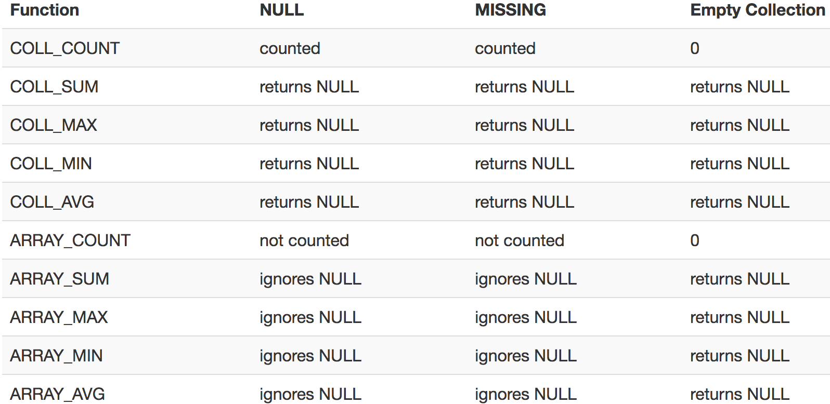
Grouping and Aggregates
Notes:
Count(*) counts those that are null! (just like SQL)

Slide 128
Grouping and Aggregates
C
[{A:a1, F:[{B:b1}, {B:b2}], G:[{C:c1}]}, {A:a2, F:[{B:b3}, {B:b4}, {B:null}], G:[ ]}, {A:a3, F:[{B:b6}], G:[{C:c2},{C:c3}]}]
Count the number of elements in the F array for each A
SELECT x.A, COLL_COUNT(x.F) AS cnt
FROM C AS x
These are NOT equivalent!
SELECT x.A, COUNT(*) AS cnt
FROM C AS x, x.F AS y
GROUP BY x.A
Notes:
C is a nested collection with nested array F

Slide 129
Joins
Two flat collections:
coll1 = [{A:a1, B:b1}, {A:a1, B:b2}, {A:a2, B:b1}]
coll2 = [{B:b1, C:c1}, {B:b1, C:c2}, {B:b3, C:c3}]
Answer
SELECT x.A, x.B, y.C
FROM coll1 AS x, coll2 AS y
WHERE x.B = y.B
[{A:a1, B:b1, C:c1},
{A:a1, B:b1, C:c2},
{A:a2, B:b1, C:c1},
{A:a2, B:b1, C:c2}]
SELECT x.A, x.B, y.C
FROM coll1 AS x JOIN coll2 AS y ON x.B = y.B

Slide 130
Outer Joins
Two flat collection
coll1
[{A:a1, B:b1}, {A:a1, B:b2}, {A:a2, B:b1}]
coll2
[{B:b1, C:c1}, {B:b1, C:c2}, {B:b3, C:c3}]
SELECT x.A, x.B, y.C
FROM coll1 AS x RIGHT OUTER JOIN coll2 AS y
ON x.B = y.B
Answer
[{A:a1, B:b1, C:c1},
{A:a1, B:b1, C:c2},
{A:a2, B:b1, C:c1},
{A:a2, B:b1, C:c2},
{B:b3, C:c3}]
Notes:
No nulls! The missing fields are simply dropped

Slide 131
Ordering
coll1
[{A:a1, B:b1}, {A:a1, B:b2}, {A:a2, B:b1}]
SELECT x.A, x.B
FROM coll AS x
ORDER BY x.A
Data type matters!
"90" > "8000" but
90 < 8000 !
Notes:
No nulls! The missing fields are simply dropped

Slide 132
Multi-Value Join
Recall: a many-to-one relation should have one foreign key, from “many” to “one”
Sometimes people represent it in the opposite direction, from “one” to “many”:
The reference is a string of keys separated by space
Need to use split(string, separator) to split it into a collection of foreign keys

Slide 133
Multi-Value Join
river
[{"name": "Donau", "-country": "SRB A D H HR SK BG RO MD UA”},
{"name": "Colorado”, "-country": "MEX USA"},
... ]
SELECT ...
FROM country AS x, river AS y, split(y. `-country`, " ") AS z
WHERE x.`-car_code` = z
String
Separator
A collection
split("MEX USA", " ") = ["MEX", "USA"]
Notes:
Split returns a collection that can be subsequently joined

Slide 134
Behind the Scenes
Query Processing on NFNF data:
Option 1: give up on evaluating multiple query plans, use standard java/python-like execution
Option 2: represent the data as a collection of flat tables, convert SQL++ to a standard relational query plan

Slide 135
Flattening SQL++ Queries
A nested collection
coll = [{A:a1, F:[{B:b1},{B:b2}], G:[{C:c1}]}, {A:a2, F:[{B:b3},{B:b4},{B:b5}], G:[ ]}, {A:a1, F:[{B:b6}], G:[{C:c2},{C:c3}]}]

Slide 136
Flattening SQL++ Queries
A nested collection
Relational representation
coll:
id | A
1 | a1
2 | a2
3 | a1
F
parent | B
1 | b1
1 | b2
2 | b3
2 | b4
2 | b5
3 | b6
G
parent | C
1 | c1
3 | c2
3 | c3
coll = [{A:a1, F:[{B:b1},{B:b2}], G:[{C:c1}]}, {A:a2, F:[{B:b3},{B:b4},{B:b5}], G:[ ]}, {A:a1, F:[{B:b6}], G:[{C:c2},{C:c3}]}]

Slide 137
Flattening SQL++ Queries
A nested collection
Relational representation
coll:
id | A
1 | a1
2 | a2
3 | a1
F
parent | B
1 | b1
1 | b2
2 | b3
2 | b4
2 | b5
3 | b6
G
parent | C
1 | c1
3 | c2
3 | c3
coll = [{A:a1, F:[{B:b1},{B:b2}], G:[{C:c1}]}, {A:a2, F:[{B:b3},{B:b4},{B:b5}], G:[ ]}, {A:a1, F:[{B:b6}], G:[{C:c2},{C:c3}]}]
SQL++
SELECT x.A, y.B FROM coll x, x.F y
WHERE x.A = “a1”

Slide 138
Flattening SQL++ Queries
A nested collection
Relational representation
coll:
id | A
1 | a1
2 | a2
3 | a1
F
parent | B
1 | b1
1 | b2
2 | b3
2 | b4
2 | b5
3 | b6
G
parent | C
1 | c1
3 | c2
3 | c3
coll = [{A:a1, F:[{B:b1},{B:b2}], G:[{C:c1}]}, {A:a2, F:[{B:b3},{B:b4},{B:b5}], G:[ ]}, {A:a1, F:[{B:b6}], G:[{C:c2},{C:c3}]}]
SQL++
SQL
SELECT x.A, y.B FROM coll AS x, x.F AS y
WHERE x.A = “a1”
SELECT x.A, y.B
FROM coll AS x, F AS y
WHERE x.id = y.parent AND x.A = “a1”

Slide 139
Flattening SQL++ Queries
A nested collection
Relational representation
coll:
id | A
1 | a1
2 | a2
3 | a1
F
parent | B
1 | b1
1 | b2
2 | b3
2 | b4
2 | b5
3 | b6
G
parent | C
1 | c1
3 | c2
3 | c3
coll = [{A:a1, F:[{B:b1},{B:b2}], G:[{C:c1}]}, {A:a2, F:[{B:b3},{B:b4},{B:b5}], G:[ ]}, {A:a1, F:[{B:b6}], G:[{C:c2},{C:c3}]}]
SQL++
SQL
SELECT x.A, y.B FROM coll AS x, x.F AS y
WHERE x.A = “a1”
SELECT x.A, y.B
FROM coll AS x, F AS y
WHERE x.id = y.parent AND x.A = “a1”
SELECT x.A, y.B FROM coll AS x, x.F AS y, x.G AS z
WHERE y.B = z.C

Slide 140
Flattening SQL++ Queries
A nested collection
Relational representation
coll:
id | A
1 | a1
2 | a2
3 | a1
F
parent | B
1 | b1
1 | b2
2 | b3
2 | b4
2 | b5
3 | b6
G
parent | C
1 | c1
3 | c2
3 | c3
coll = [{A:a1, F:[{B:b1},{B:b2}], G:[{C:c1}]}, {A:a2, F:[{B:b3},{B:b4},{B:b5}], G:[ ]}, {A:a1, F:[{B:b6}], G:[{C:c2},{C:c3}]}]
SQL++
SQL
SELECT x.A, y.B FROM coll AS x, x.F AS y
WHERE x.A = ‘a1’
SELECT x.A, y.B
FROM coll AS x, F AS y
WHERE x.id = y.parent AND x.A = ‘a1’
SELECT x.A, y.B
FROM coll AS x, F AS y, G AS z
WHERE x.id = y.parent AND
x.id = z.parent AND y.B = z.C
SELECT x.A, y.B FROM coll AS x, x.F AS y, x.G AS z
WHERE y.B = z.C

Slide 141
XML
<person>
<name> Mary </name>
<address>
<street> Maple </street>
<no>345 </no>
<city> Seattle </city>
</address>
</person>
<person>
<name> John</name>
<address> Thailand </address>
<phone> 2345678 </phone>
</person>

Slide 142
XML
Begin tag
<person>
<name> Mary </name>
<address>
<street> Maple </street>
<no>345 </no>
<city> Seattle </city>
</address>
</person>
<person>
<name> John</name>
<address> Thailand </address>
<phone> 2345678 </phone>
</person>
Element
End tag

Slide 143
XML
Begin tag
<person>
<name> Mary </name>
<address>
<street> Maple </street>
<no>345 </no>
<city> Seattle </city>
</address>
</person>
<person>
<name> John</name>
<address> Thailand </address>
<phone> 2345678 </phone>
</person>
Element
(nested) Element
End tag

Slide 144
XML
Begin tag
<person>
<name> Mary </name>
<address>
<street> Maple </street>
<no>345 </no>
<city> Seattle </city>
</address>
</person>
<person>
<name> John</name>
<address> Thailand </address>
<phone> 2345678 </phone>
</person>
Element
(nested) Element
(nested) Element
End tag

Slide 145
XML Attributes
<person id = “23”>
<name > Mary </name>
<address> Seattle </address>
</person>
<person id = “55”>
<name> John</name>
<address> Thailand </address>
</person>
<person>
<id> 23 </id>
<name> Mary </name>
<address> Seattle </address>
</person>
<person>
<id> 55 </id>
<name> John</name>
<address> Thailand </address>
</person>

Slide 146
Document Type Definitions (DTD)
An XML document may have a DTD
XML document:
Well-formed = if tags are correctly closed
Valid = if it has a DTD and conforms to it!
Validation is useful in data exchange
Use http://validator.w3.org/check to validate
Superseded by XML Schema (Book Sec. 11.4)
Very complex: DTDs still used widely

Slide 147
DDT example
<!DOCTYPE company [
<!ELEMENT company ((person|product)*)>
<!ELEMENT person (ssn, name, office, phone?)>
<!ELEMENT ssn (#PCDATA)>
<!ELEMENT name (#PCDATA)>
<!ELEMENT office (#PCDATA)>
<!ELEMENT phone (#PCDATA)>
<!ELEMENT product (pid, name, description?)>
<!ELEMENT pid (#PCDATA)>
<!ELEMENT description (#PCDATA)>
]>

Slide 148
DDT example
<company>
<person> <ssn> 123456789 </ssn>
<name> John </name>
<office> B432 </office>
<phone> 1234 </phone>
</person>
<person> <ssn> 987654321 </ssn>
<name> Jim </name>
<office> B123 </office>
</person>
<product> ... </product>
...
</company>
Valid XML Document

Slide 149
Querying XML Data
XPath : simple navigation
XQuery : SQL for XML
XSLT : recursive traversal

Slide 150
Semistructured Data Model
Several file formats: JSON, protobuf, XML
Note: the data model is tree-structured
They differ in how they handle structure:
Open or closed
Ordered or unordered
Query language needs to take NFNF into account
Various “extra” constructs introduced as a result

Slide 151
Conclusions
Alternatives to the Relational Model are emerging
Geographically distributed data
Semi-structured data suited for data exchange
geospatial data and Nearest Neighbor queries
graph databases (nodes and edges)
e.g., <links to> and <friends with> relationships
Scaling out to Cloud services providers
SLAs and Technical support
However, relaxed consistency is not appropriate for most transaction processing workloads
Notes:
These are not hard and fast rules!

